Slide 1
Off-Label Drug Use during the COVID-19 Pandemic in Africa: The Case of Ivermectin
Prof. Jude’s Lab Meeting
Zahra

Slide 2
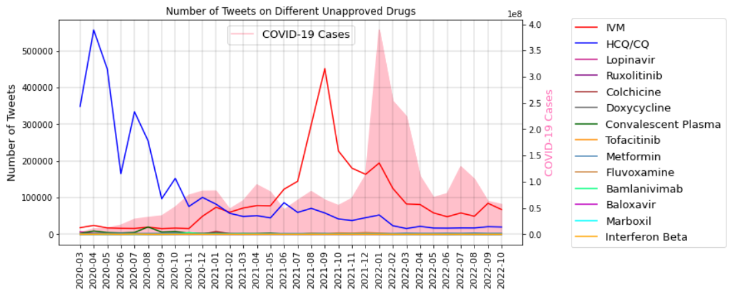
Off-Label Drugs for COVID-19
Several substances were frequently used for treatment or prevention of COVID-19, although rejected by the World Health Organization (WHO):
Ivermectin
Hydroxychloroquine/Chloroquine
Lopinavir
Ruxolitinib
Colchicine
Doxycycline
Convalescent Plasma
Tofacitinib
Metformin
Fluvoxamine
Bamlanivimab
Baloxavir
Marboxil
Interferon Beta

Slide 3
Ivermectin
Ivermectin has been strictly rejected by World Health Organization (WHO) for treatment or prevention of COVID-19:
Many studies have confirmed that Ivermectin has anti-viral properties against RNA viruses such as SARS-COV-2 in vitro.
However, randomized clinical trial rejects the efficacy of Ivermectin.
The Ivermectin dosage required to reach vitro efficacy is very high and toxic to human body.
Ivermectin toxicity include weakness, confusion, hallucination, nausea, vomiting, diarrhea, seizure, coma, and death.
Since, people did not stop consuming Ivermectin for COVID-19 treatment and prevention, it was only provided by prescription for curing parasites in many countries.
Unfortunately, this caused a black market in many countries. Some even consumed the veterinary formulation of Ivermectin in attempt of treating or preventing COVID-19.
As a result, those who were genuinely in need of Ivermectin (e.g. for parasites, for their pet/livestock) had a hard time finding it.
Above all, many ivermectin supporters developed anti-vax believes.

Slide 4
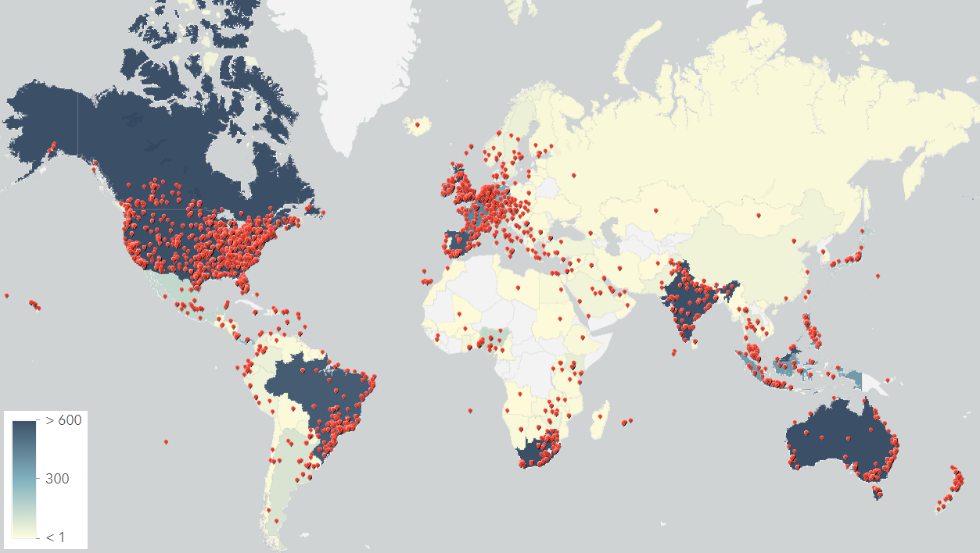
Contribution
Social media could help us understand
The rationality of Ivermectin-supporters for promoting the drug, or even using the animal formulation.
The emotions of Ivermectin supporters.
Statistics on gender and location of Ivermectin supporters
We concentrate on Nigeria and
South Africa
This could be highly beneficial to
policy-makers and health officials
for preventing people from
off-label administration of
Ivermectin.

Slide 5
Methodology
Geotagged and non-geotagged tweets were gathered from March 1, 2020 to October 31, 2022 with keywords “ivermectin” and “ivm”.
After cleaning and removing null tweets and duplicates, tweets posted from Nigeria and South Africa were extracted using the geolocation and user-specified location of the tweets.
1966 and 22809 tweets are pulled out for Nigeria and South Africa, respectively.
Using topic modeling, the discussions regarding Ivermectin are classified into 11 topics.
A model is fine-tuned on RoBERTa stance detection.
Emotion analysis is performed using pretrained models.
Gender and location information of the tweets are extracted for further analysis

Slide 6
Methodology
Geotagged and non-geotagged tweets were gathered from March 1, 2020 to October 31, 2022 with keywords “ivermectin” and “ivm”.
After cleaning and removing null tweets and duplicates, tweets posted from Nigeria and South Africa were extracted using the geolocation and user-specified location of the tweets.
1966 and 22809 tweets are pulled out for Nigeria and South Africa, respectively.
Using topic modeling, the discussions regarding Ivermectin are classified into 11 topics.
A model is fine-tuned on RoBERTa stance detection.
Emotion analysis is performed using pretrained models.
Gender and location information of the tweets are extracted for further analysis

Slide 7
Topic Modeling
Eleven topics give insight on rationality behind Ivermectin.
Topic | Ivermectin opposers example | Ivermectin supporters example
Consuming animal formulation of Ivermectin | You are not a horse. You are not a cow. Seriously, y'all. Stop it | You can get ivermectin in a paste form at animal feed stores. ppl who had Covid used it and was 100% in 3 days
Waiting for official Decision on Ivermectin | Ivermectin is still hugely controversial as treatment for COVID19. No consensus yet. Prefer to wait until there is. | My dad died from Covid-19 while waiting for ivermectin application approval
Early treatment with Ivermectin | A recent clinical study again show high-dose ivermectin does not work for early treatment of COVID-19 | 250K South Africans are dead cause of ignoring early treatment. Ur voice was silent on IVM cause agenda was vax.
Ivermectin dosage/usage instructions | Ivermectin used in a higher dose than approved for parasitosis | have an Ivermectin 18mg tablets once a day only a week for 8 weeks plus 150mg aspirin a day for 30 days
Ivermectin and big pharma | The Big Pharma company that makes Ivermectin (and would make $billions if it did) says it doesn’t cure covid | Big Pharma are no longer going to make big money from vaccine. IVERMECTIN is cheap
Ivermectin is/isn’t anti-parasite/viral/inflammatory | Because IVM is an anti-parasatic. Covid is a virus. An anti-parasatic does not magically become an anti-viral. | In addition to anti-viral and anti-inflammatory actions, ivermectin also reduces coagulation making it ideal for covid
Ivermectin reduces/brings symptoms | Popular Drug, Ivermectin, Does Not Alleviate Mild Covid-19 Symptoms, Study Finds | Takes Ivermectin, so you would expect mild symptoms.
Mass use of Ivermectin in some countries | Any studies to report on from India? cases and deaths out of control, people swallow Ivermectin by the thousands. | Where Ivermectin has been used numbers are down, no hospital cases, no vaccine. E.g. India, Mexico, Slovakia
Clinical trials of Ivermectin | Randomized, double blinded clinical trials show that not only IVM does nothing but also worsens in hospital. | Ivermectin haters don't want to see thousands of lives saved. They only want to see randomized trials.
Ivermectin/vaccines are toxic | True, so why is emergency use of IVM OK, but roll out of a tested vaccine not? | Same with ivermectin. They couldn’t get emergency use approval for vaccines if there were other therapeutic treatments
News/research on Ivermectin | When fraudulent studies are excluded from the meta-analysis, ivermectin's benefit disappears. | Ivermectin is the most effective preventive treatment and cure of COVID19 variants.

Slide 8
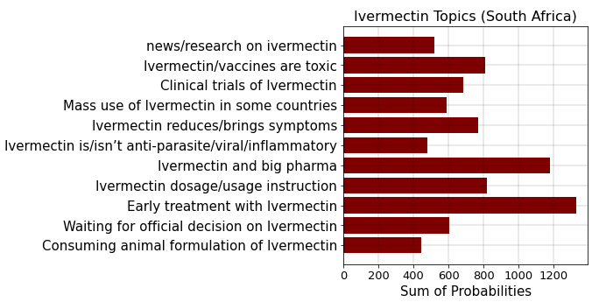
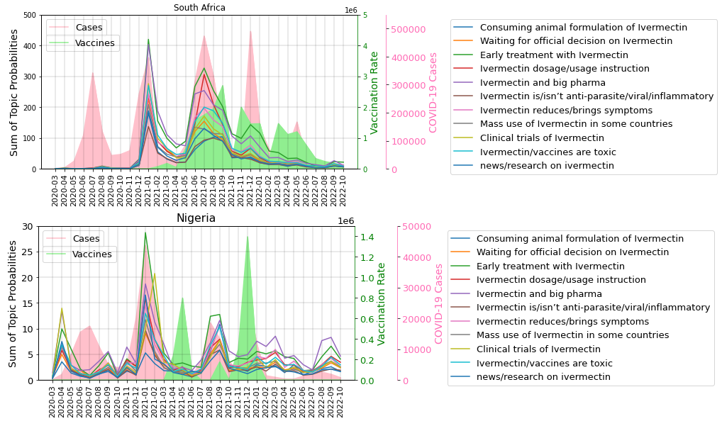
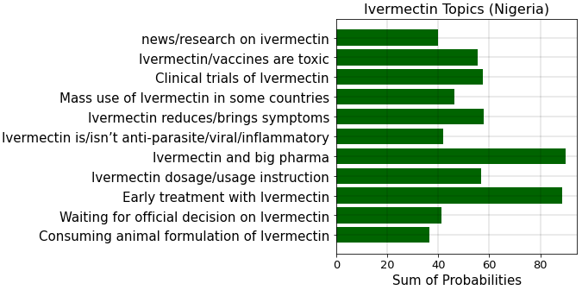
Topic Modeling
In both countries, two topics were discussed the most:
Early treatment with Ivermectin
Ivermectin and big pharma
Sum of probabilities on different topics for the two countries are 97% correlated (p-value=3.43×${10}^{−7}$)

Slide 9
Stance Detection
A model fine-tuned on RoBERTa to detect the stance of the tweets.
Tweets are manually labeled into three classes:
Pro-Ivermectin
Anti-Ivermectin
Neutral
After balancing the labeled dataset, 2842 tweets are left of which 2660 are used for training and the rest for testing the model.
 | Precision | Recall | F1-Score | Accuracy
Pro-Ivermectin | 76% | 74% | 75% | 74%
Anti-Ivermectin | 69% | 80% | 74%
Neutral | 77% | 67% | 71%

Slide 10
Stance Detection
A p-value of 0.0086 for the chi-score tests suggests that the stance distribution on different topics is very different for the two countries.

Slide 11
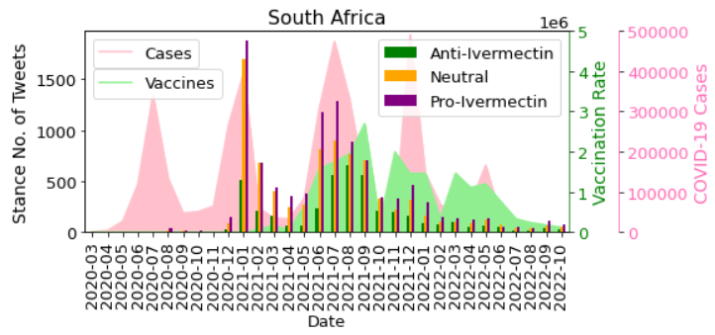
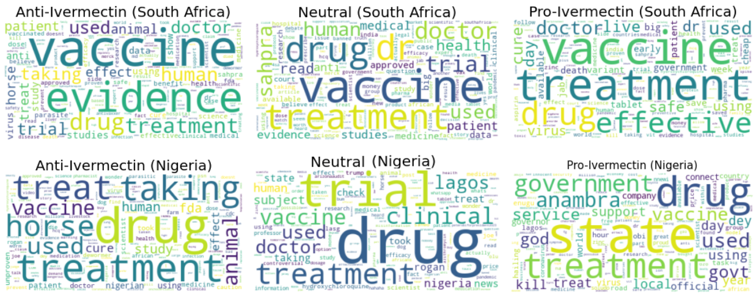
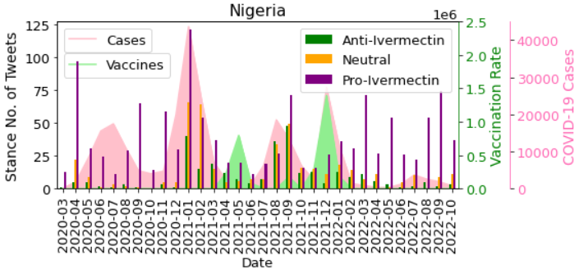
Stance Detection
There is a great debate between Ivermectin and vaccines on social media

Slide 12
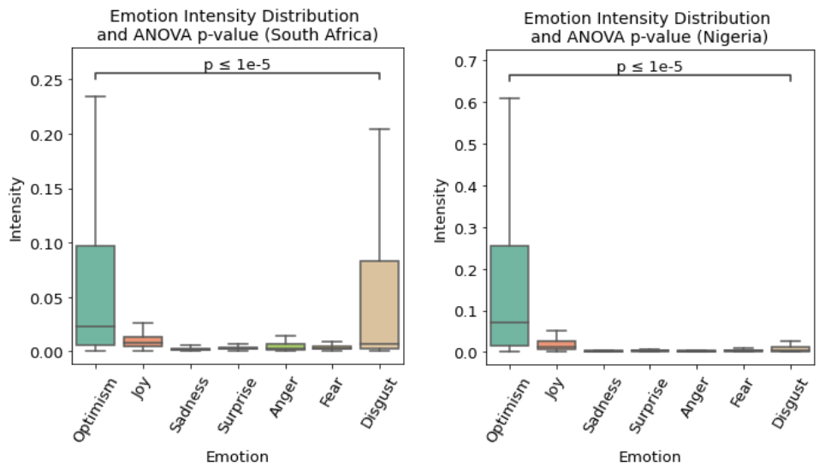
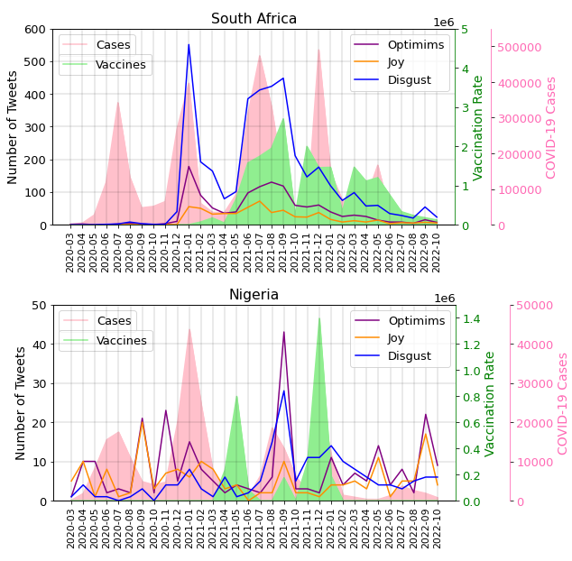
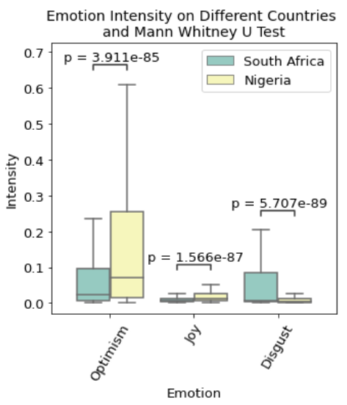
Emotion Analysis
Using two pretrained models (pysentimiento and CardiffNLP) emotions of the tweets were classified into 7 classes:
Optimism, Joy, Surprise, Sadness, Anger, Fear, Disgust
The intensity of positive emotions is higher in Nigeria.

Slide 13
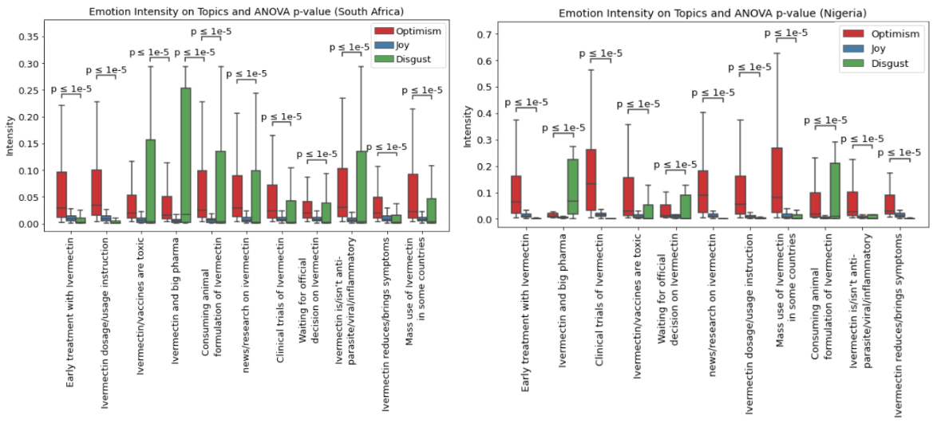
Emotion Analysis

Slide 14
Gender and Location
To recognise the gender of the tweets, first bots were removed using the source field of the tweets.
Using the profile image of the users, and their tweets, the gender of the tweets were recognised with 85% accuracy.
In both countries, 20% of the users who posted tweets related to Ivermectin were female, and 80% were male.
The gender of 1289 and 16117 of the users from Nigeria and South Africa were recognised, respectively.
The province of the tweets was identified using the geolocation and user-specified location of the tweets.
The province of 1417 and 15430 of the tweets was identified for Nigeria and South Africa, respectively.

Slide 15
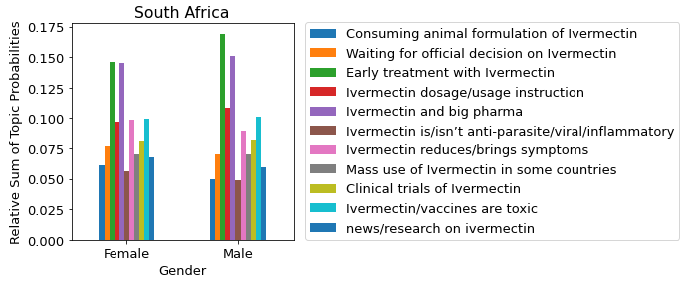
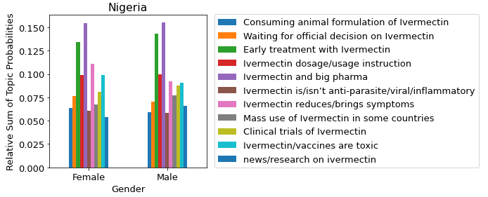
Gender and Topics
Distribution of topics on different genders is similar for the two countries.
Women: 98% correlated with p-value of 2.23×${10}^{−8}$
Men: 95% correlated with p-value of 3.31 ×${10}^{−6}$

Slide 16
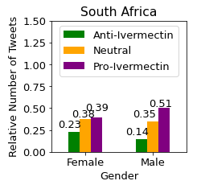
Gender and Stance
A chi-score p-value of 0.006 shows that the distribution of stance on different genders is very different for the two countries.

Slide 17
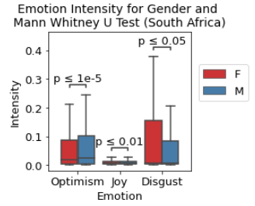
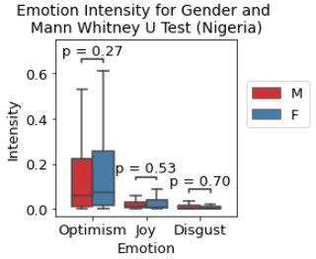
Gender and Emotion
Women and men have opposite emotion intensities in the two countries.

Slide 18
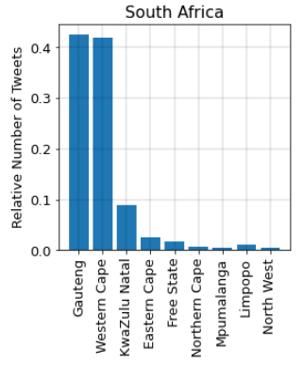
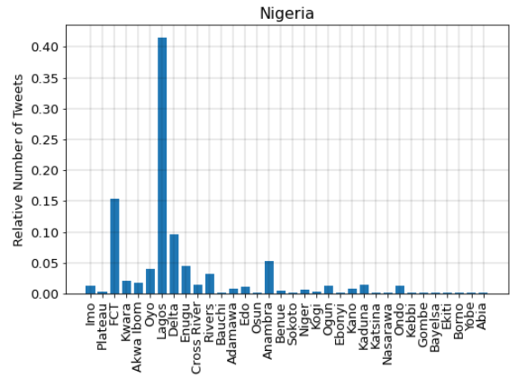
Location
The distribution of tweets on different provinces are not equal.

Slide 19
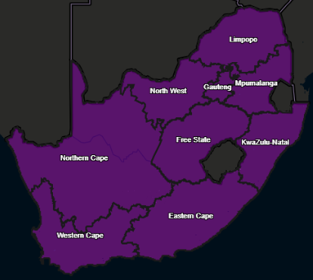
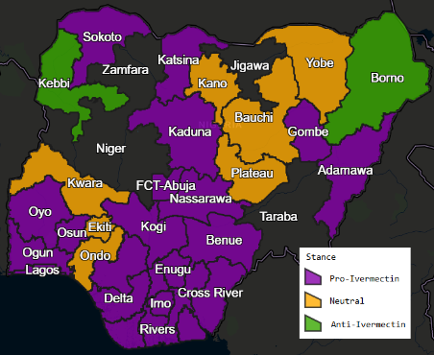
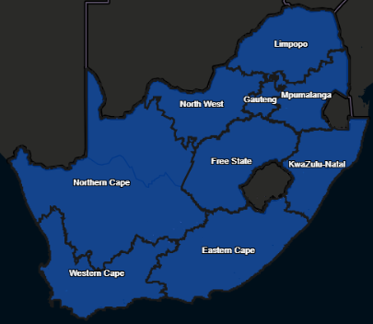
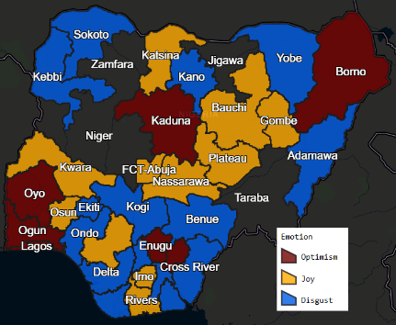
Location and Stance/Emotion

Slide 20
Conclusion
Tweets posted by Ivermectin supporters could be classified into three classes:
The first group refer to the many flawed studies that support the efficacy of Ivermectin against SARS-COV-2 in vitro.
Discussions from this group such as early treatment for COVID-19 and Ivermectin reduces symptoms are mostly optimistic.
This could be a great lesson to future crises and epidemics.
The second group exemplifies countries that have approved Ivermectin for mass use against COVID-19 such as India, Mexico, and Australia as a success story of Ivermectin, regardless of how dangerous and life-threatening this act could be.
These tweets also dominantly have optimism and joy emotions.

Slide 21
Conclusion
The third group of tweets are the result of conspiratorial quotes narrated by influencers.
Social media is overwhelmed by conspiracy theories such as:
Ivermectin is rejected for emergency approval of the vaccines
this pandemic is planned to cause fear and enforce vaccines, that is why Ivermectin cannot be approved
Ivermectin is cheap unlike vaccines and does not profit big pharma even the manufacturing company, Merk
These tweets are propagated with intense disgust.
This has caused accessing true and accurate information difficult for those who seek for them.
there is an urgent need to propagate true information
Pharmacists could play an important role in this context as they are the first place people encounter for accessing medicine

Slide 22
Please Review

