Slide 1
Guide to Accessing Microdata Through Statistics Canada
Kong Lab Meeting
May 19 2023
Taylor Cargill

Slide 2
Steps
Selecting a Statistics Canada (StatCan) dataset
Finding a local Research Data Centre (RDC)
Reviewing application guidelines
Creating a research proposal
Approval and data access

Slide 3
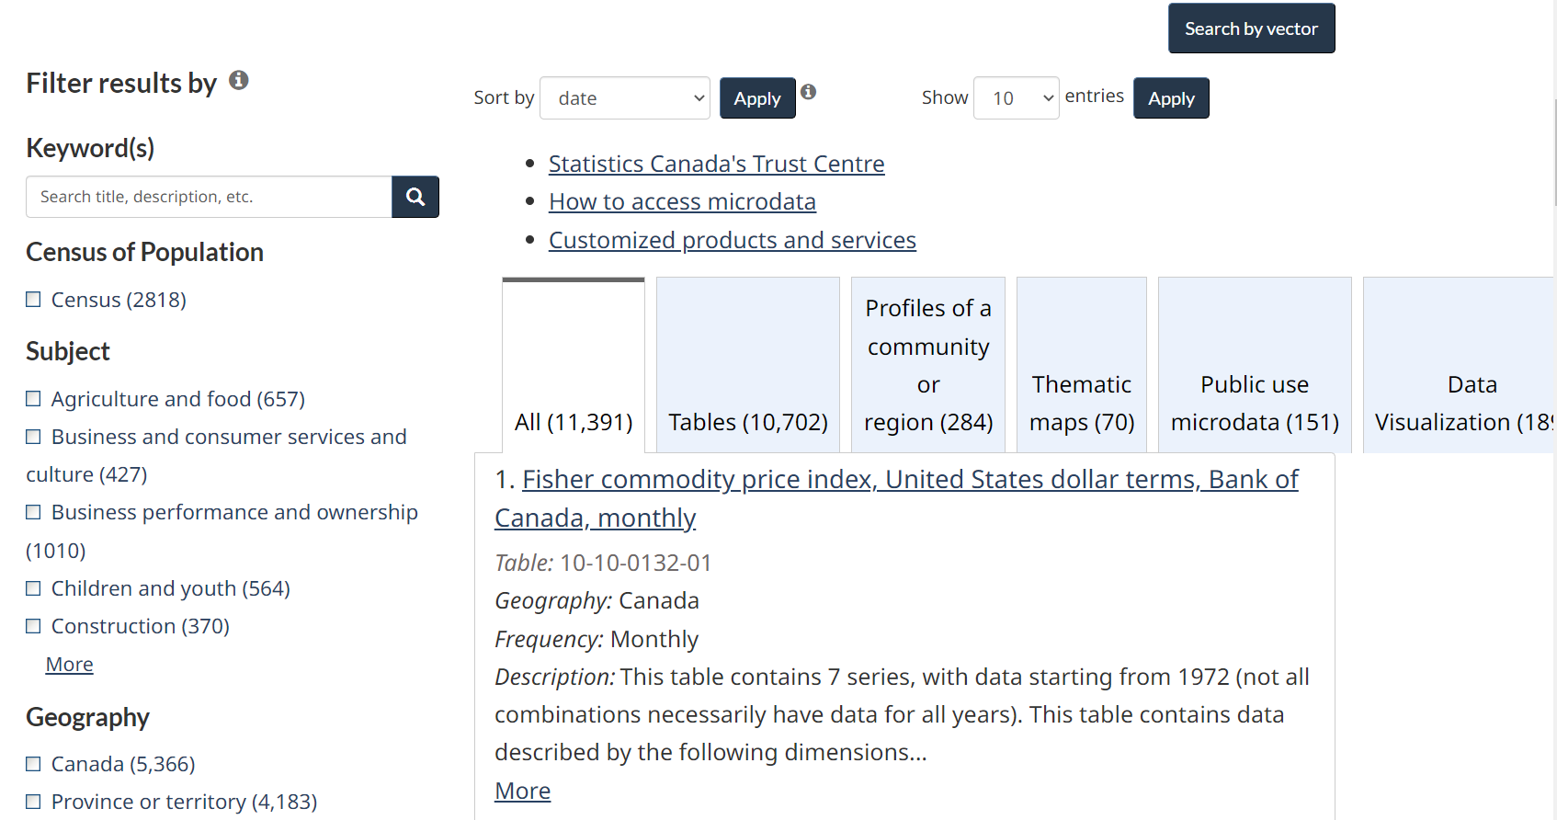
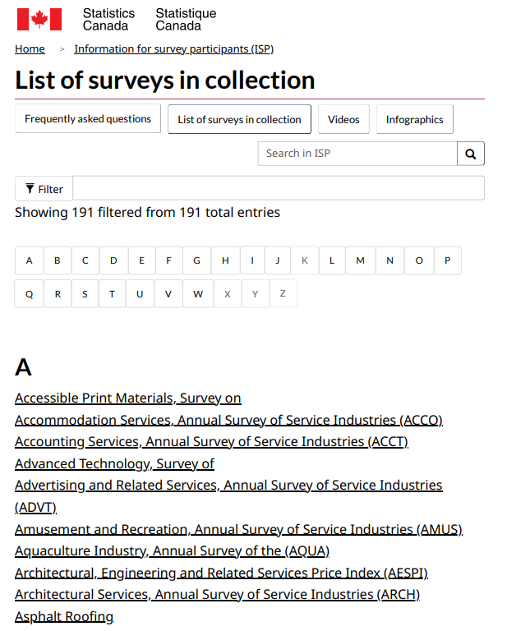
1) Selecting a Dataset
Search for datasets through Data keyword search or Survey List
i) Keyword search on Data page
ii) Survey List
https://www150.statcan.gc.ca/n1/en/type/data?MM=1
https://www.statcan.gc.ca/en/survey/list

Slide 4
1) Selecting a Dataset
Search for datasets through Data keyword search or Survey List
i) Keyword search on Data page
ii) Survey List
https://www150.statcan.gc.ca/n1/en/type/data?MM=1
https://www.statcan.gc.ca/en/survey/list

Slide 5
1) Selecting a Dataset
Search for datasets through Data keyword search or Survey List
i) Keyword search on Data page
ii) Survey List
https://www150.statcan.gc.ca/n1/en/type/data?MM=1
https://www.statcan.gc.ca/en/survey/list

Slide 6
1) Selecting a Dataset
Search for datasets through Data keyword search or Survey List
i) Keyword search on Data page
ii) Survey List
https://www150.statcan.gc.ca/n1/en/type/data?MM=1
https://www.statcan.gc.ca/en/survey/list

Slide 7
2) Finding a local Research Data Centre (e.g., York RDC)
A Research Data Centre (RDC) is a facility staffed by a Statistics Canada Analyst, which offers researchers:
Secure access to confidential microdata – Statistics Canada census and surveys,
Administrative data
Fully-equipped workstations, statistical software and technical support
There are more than 30 RDCs on university campuses across Canada – including York University.
York University RDC: https://www.yorku.ca/research/isr/centres/statistics-canada-research-data-centre/
Location: York Lanes Room 282

Slide 8
3) Reviewing Application Guidelines
Application process for accessing Microdata includes:
Creating profiles for each project researcher in the Microdata Access Portal (MAP)
Creating a Project Proposal
Filling out a Fee-for Service questionnaire form
https://www.statcan.gc.ca/en/microdata/data-centres/forms

Slide 9
4) Creating Research Proposal
Project Title
Project description, rationale, and objectives
Proposed data requirements
Methodology
External data
Software requirements
Expected output
Funding
Literature References
https://www.statcan.gc.ca/en/microdata/data-centres/forms

Slide 10
5) Approval and Data Access
Onboarding forms, training/orientation, gain access to the RDC for using the microdata
Support offered by the Library Data Services on finding datasets, and conducting analyses
https://yorku.libcal.com/appointments/data

Slide 11
Thank You
Resources/Links:
StatCan - https://www.statcan.gc.ca/en/start
Canadian Research Data Network - https://crdcn.ca/
YorkU RDC Research Guides for Data & Statistics - https://researchguides.library.yorku.ca/data/data-rdc
Microdata Access Application - https://www.statcan.gc.ca/en/microdata/data-centres/access

