Slide 1
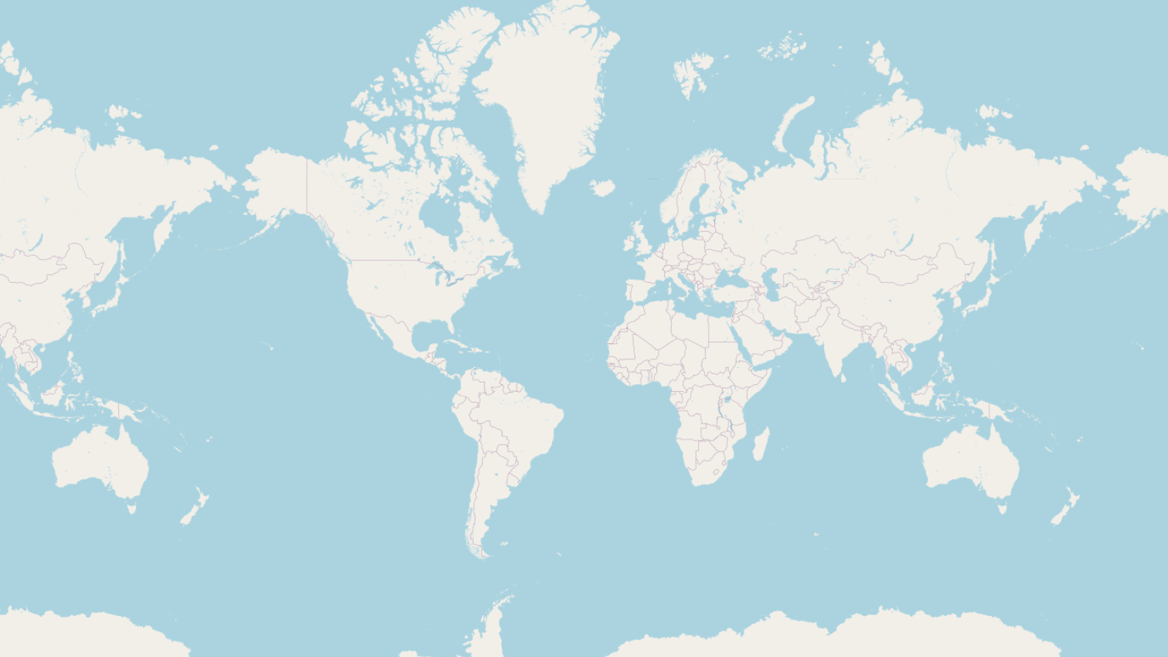
Simple Mapmaking in RStudio
Taylor Cargill

Slide 2
Workflow
Load required packages.
Add spatial information (e.g. coordinates, polygon shape, etc.) to your data.
Generate the map with mapview ().
Customize the map according to your needs.
data preparation → mapview () → customization

Slide 3
Useful Packages
The mapview package functions to quickly and conveniently make visualizations of spatial data.
The dplyr package is used to execute common data manipulation tasks.
The sf package supports Simple Feature objects in R, and provides an interface for working with spatial and geographic data.
Install
packages

Slide 4
The mapview () function
The mapview package functions to quickly and conveniently make visualizations of spatial data.
The dplyr package is used to execute common data manipulation tasks.
The sf package supports Simple Feature objects in R, and provides an interface for working with spatial and geographic data.
To make a default map with the mapview() function, you only need a few arguments.
mydata = the name of your dataframe
xcol = longitude coordinates
ycol = latitude coordinates
zcol = the argument that colours your points/polygons depending on the value of the variable

Slide 5
Adding Spatial Information
The mapview package functions to quickly and conveniently make visualizations of spatial data.
The dplyr package is used to execute common data manipulation tasks.
The sf package supports Simple Feature objects in R, and provides an interface for working with spatial and geographic data.
Add spatial information

Slide 6
Spatial Information – Points
To plot points in mapview, you need latitude and longitude coordinates.
If your data already has coordinates, use the st_as_sf() function from the sf package to structure your data as spatial in R.
mydata = the name of your dataframe
“my_longitude_column” = the df column with longitude info
“my_latitude_column” = the df column with latitude info
crs = the coordinate reference system, e.g. ESPG 4326
st_as_sf(mydata, coordinates = c(“my_longitude_column”, “my_latitude_column”, crs=4326)

Slide 7
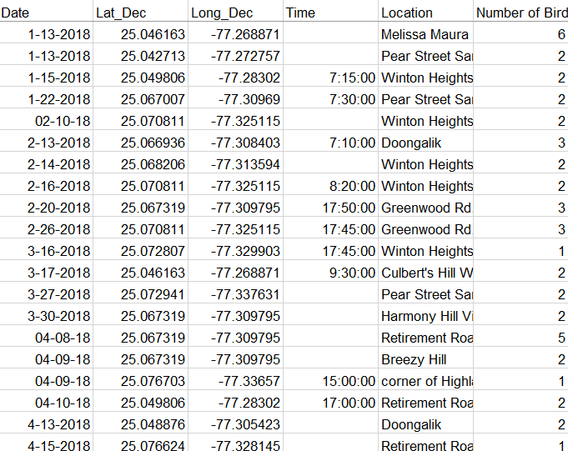
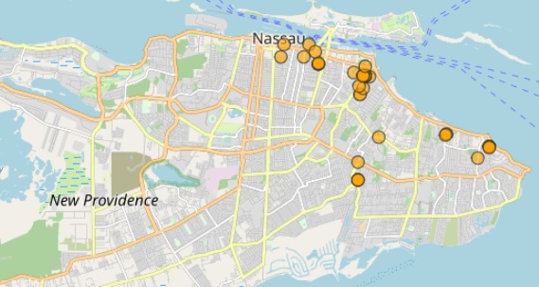
SPATIAL INFORMATION – Points
This data already has latitude and longitude coordinates, so the steps are simple:
col.regions = “colour”
To change the colour of your data points.

Slide 8
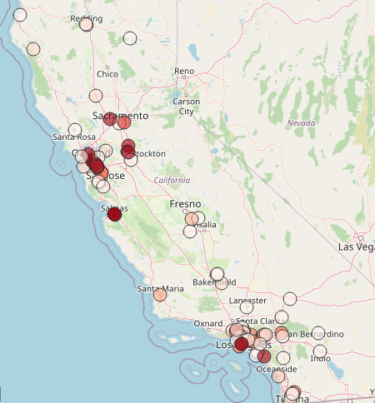
Spatial Information – Points
If your data does not have coordinates, but you have addresses, you can use the mutate_geocode () function from the ggmap package.
This function will get the coordinates from Google’s API, but you need an API key.
This code will also structure the data as spatial, so you don’t have to use st_as_sf().
mutate_geocode(your_data_with_addresses, location = your_address_column, output = “latlona”)

Slide 9
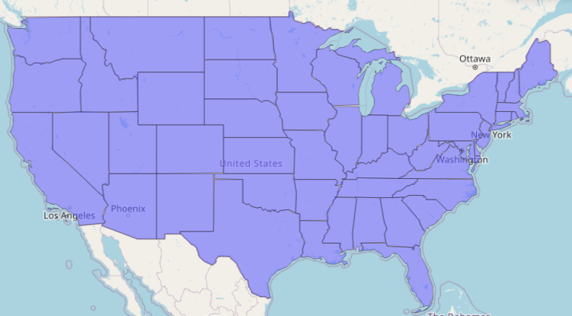
Spatial Information – Polygons
To make polygons, you can merge your data with a geojson or other shapefile information to get the boundaries around regions (e.g. cities, provinces, countries).
There are R packages containing shapefile information for many countries.
e.g., tigris package for the U.S.

Slide 10
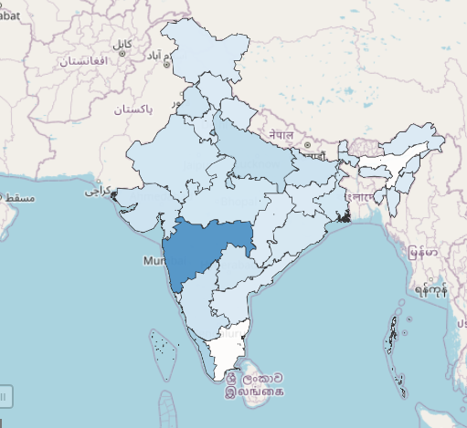
Spatial Information – Polygons
If you can’t find a built-in package for the region you are mapping, you can use a geojson file.
The function geojson_read from the geojsonio package lets you read geojson files.
You can then join the geojson to the data you are trying to visualize with the geo_join function from the tigris package.
geojson_read(“my_file_path”)
geo_join(my_geojson_file, my_data, “geojson_region_name_column”, “my_region_name_column”, how=“inner”)

Slide 11
Customizing your map
The mapview() function lets you customize your maps in many easy ways.
zcol = the argument that colours your points/polygons depending on the value of the variable
col.regions = the colour of your points/polygons
sync = a function from the leafsync package that lets you synchronize two or more maps side-by-side
native.crs = function that lets you toggle (TRUE/FALSE) whether your map is in its native projection or fitted to a maptile background.
Use mapview()
Adding a + sign between two mapview functions lets you overlay two maps on top of each other.

Slide 12
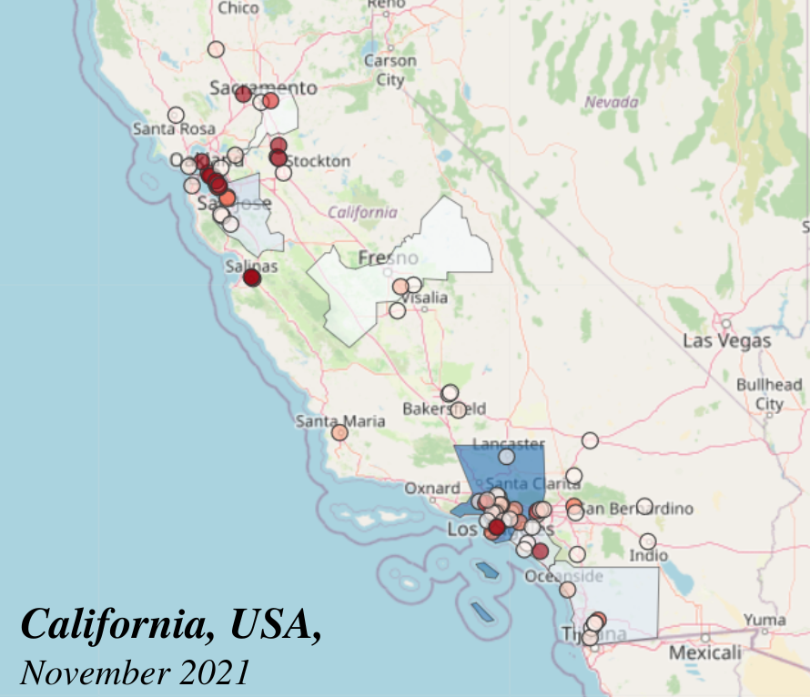
Example: Negative-sentiment Tweets and PPE shortage in California nursing homes
Use mapview()
nursing home PPE shortage = red
negative-sentiment tweets = blue

Slide 13
Thank You!

